Slide 1
AKS Landing Zone Accelerator
Karthik Narayanan
Senior Solutions Architect

Slide 2
Content

Slide 3
Business Requirement:

Slide 4
AKS Landing Zone Accelerator
Strategic design path and target technical state for an Azure Kubernetes Service (AKS) deployment.
This solution provides an architectural approach and reference implementation to prepare landing zone subscriptions for a scalable Azure Kubernetes Service (AKS) cluster.
The focus is mainly on design principles of enterprise-scale landing zone.
The AKS landing zone accelerator requires a platform foundation which takes care of the shared services (network, security, identity, and governance) to effectively construct and operationalize a landing zone.

Slide 5
What the AKS Landing Zone Accelerator Provides?
A modular approach which allows us to customize our environment variables.
Design guidelines for evaluating critical decisions.
The AKS landing zone architecture
A Microsoft-recommended AKS reference implementation based on the AKS baseline.
AKS Baseline reference:
Networking configuration
Cluster compute
Identity management
Secure data flow
Business continuity
Operations

Slide 6
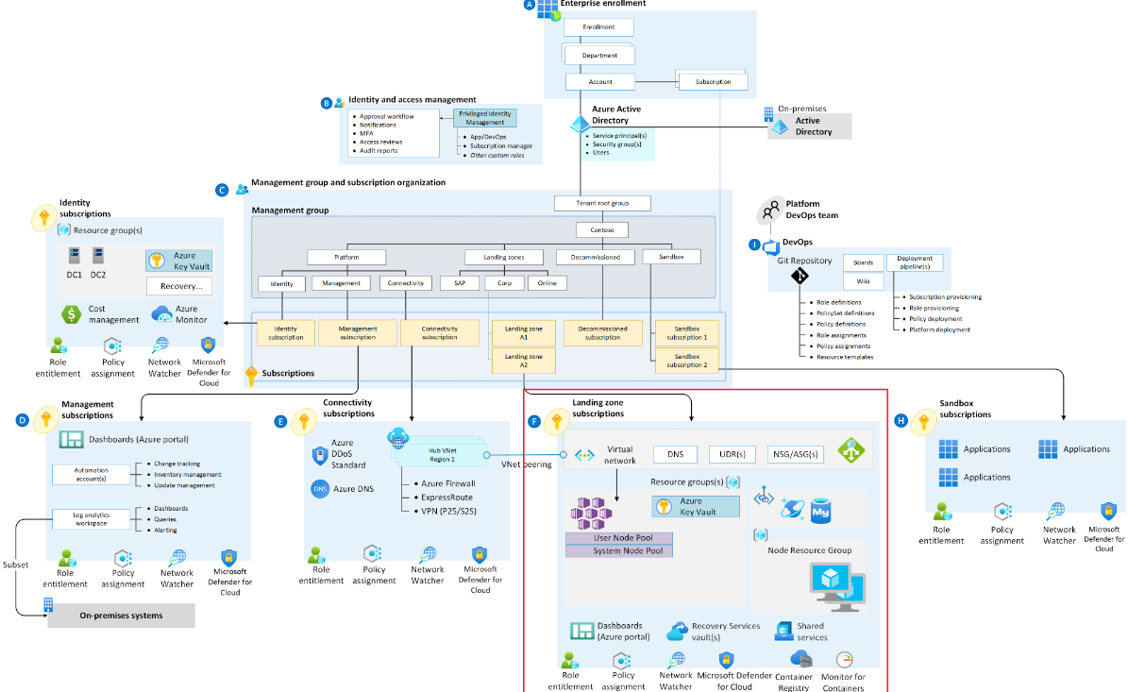
Design Areas for AKS Landing Zone Accelerator:
Identity and access management
Network topology and connectivity
Resource organization
Security
Management and BCDR
Platform automation and DevOps
Storage

Slide 7
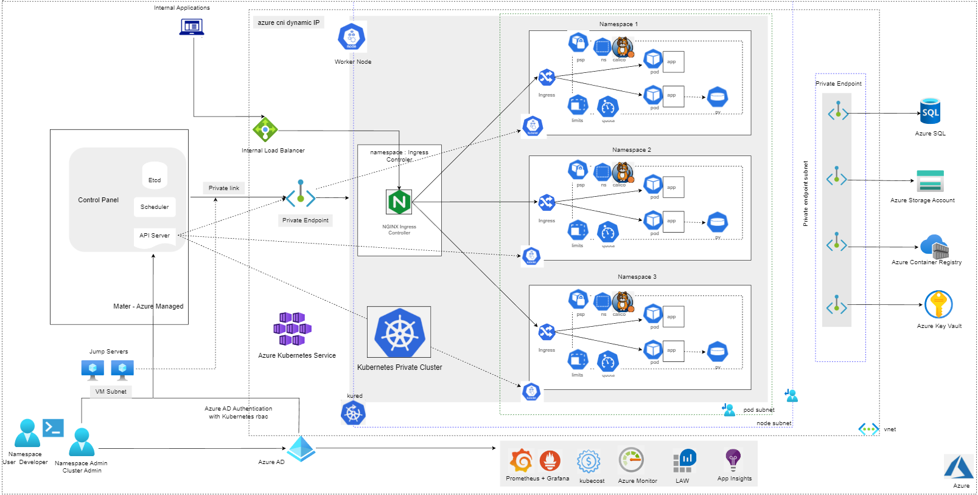
AKS Private Cluster Architecture

Slide 8
AKS private Cluster
AKS cluster IP visibility can be either public or private.
Private clusters expose the Kubernetes API over a private IP address.
This private IP address is represented in the AKS virtual network through a private endpoint. The Kubernetes API shouldn't be accessed through its IP address, but instead through its fully qualified domain name (FQDN).
The resolution from the Kubernetes API FQDN to its IP address will typically be performed by an Azure Private DNS zone.
There's no support for Azure DevOps Microsoft-hosted Agents with private clusters hence using Self-hosted Agents is recommended.
For Azure Container Registry to work with a private AKS cluster, set up a private link for the container registry in the cluster virtual network or set up peering between the Container Registry virtual network and the private cluster's virtual network.
There's no support for converting existing AKS clusters into private clusters.
Deleting or modifying the private endpoint in the customer subnet will cause the cluster to stop functioning.

Slide 9
Network Topology and Connectivity
Networking Models:
⎻Azure CNI : Azure CNI is a vendor-neutral protocol that lets the container runtime make requests to a network provider. It assigns IP addresses to pods and nodes, and provides IP address management (IPAM) features as you connect to existing Azure virtual networks.
-Azure CNI with Dynamic IP Allocation
-Azure CNI Overlay Networking
⎻Kubenet : Nodes and pods are placed on different IP subnets, User Defined Routing (UDR) and NAT is configured
Recommended Design Approach:
*Kubnet can be allowed based on usecase, when application team prefers a less complex architecture
Azure CNI Networking with Dynamic allocation of IPs

Slide 10
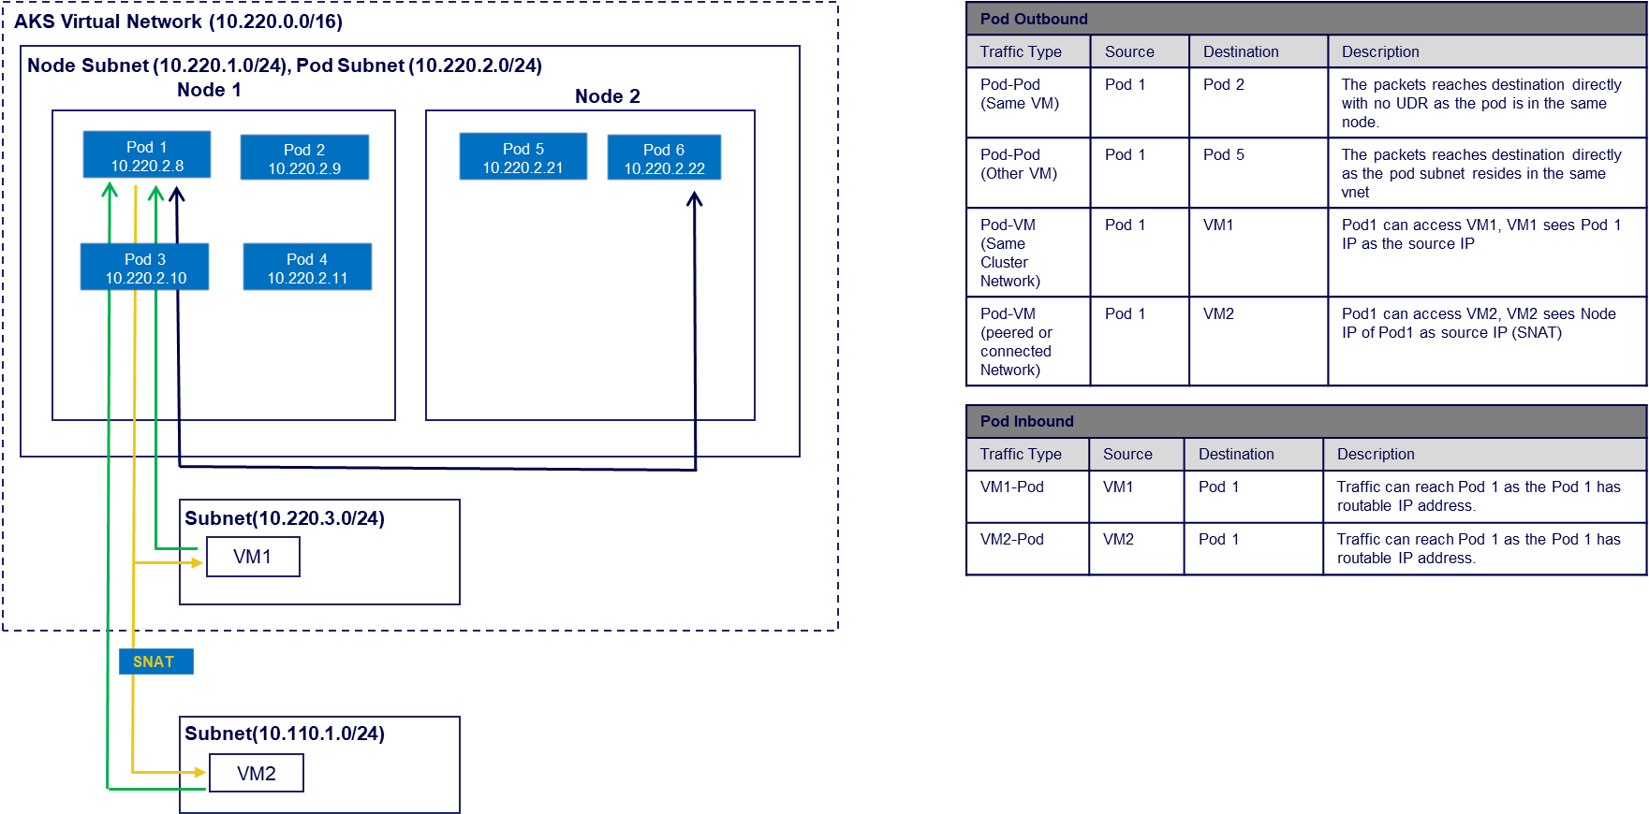
Pod Connectivity – Azure CNI with Dynamic IP Allocation
*(number of nodes + 1) + ((number of nodes + 1) * maximum pods per node that you configure)

Slide 11
Azure CNI with Dynamic allocation of IPs - Advantages
Mitigation: Overcomes the drawback with the traditional CNI i.e., the exhaustion of pod IP addresses as the AKS cluster grows.
Better IP utilization: IPs are dynamically allocated to cluster Pods from the Pod subnet.
Scalable and flexible: Node and pod subnets can be scaled independently.
High performance: Since pod are assigned VNet IPs, they have direct connectivity to other cluster pod and resources in the VNet.
Separate VNet policies for pods: Since pods have separate subnet, can configure separate VNet policies for them that are different from node policies.
Planning IP addressing is much simpler with this feature. Since the nodes and pods scale independently, their address spaces can also be planned separately.

Slide 12
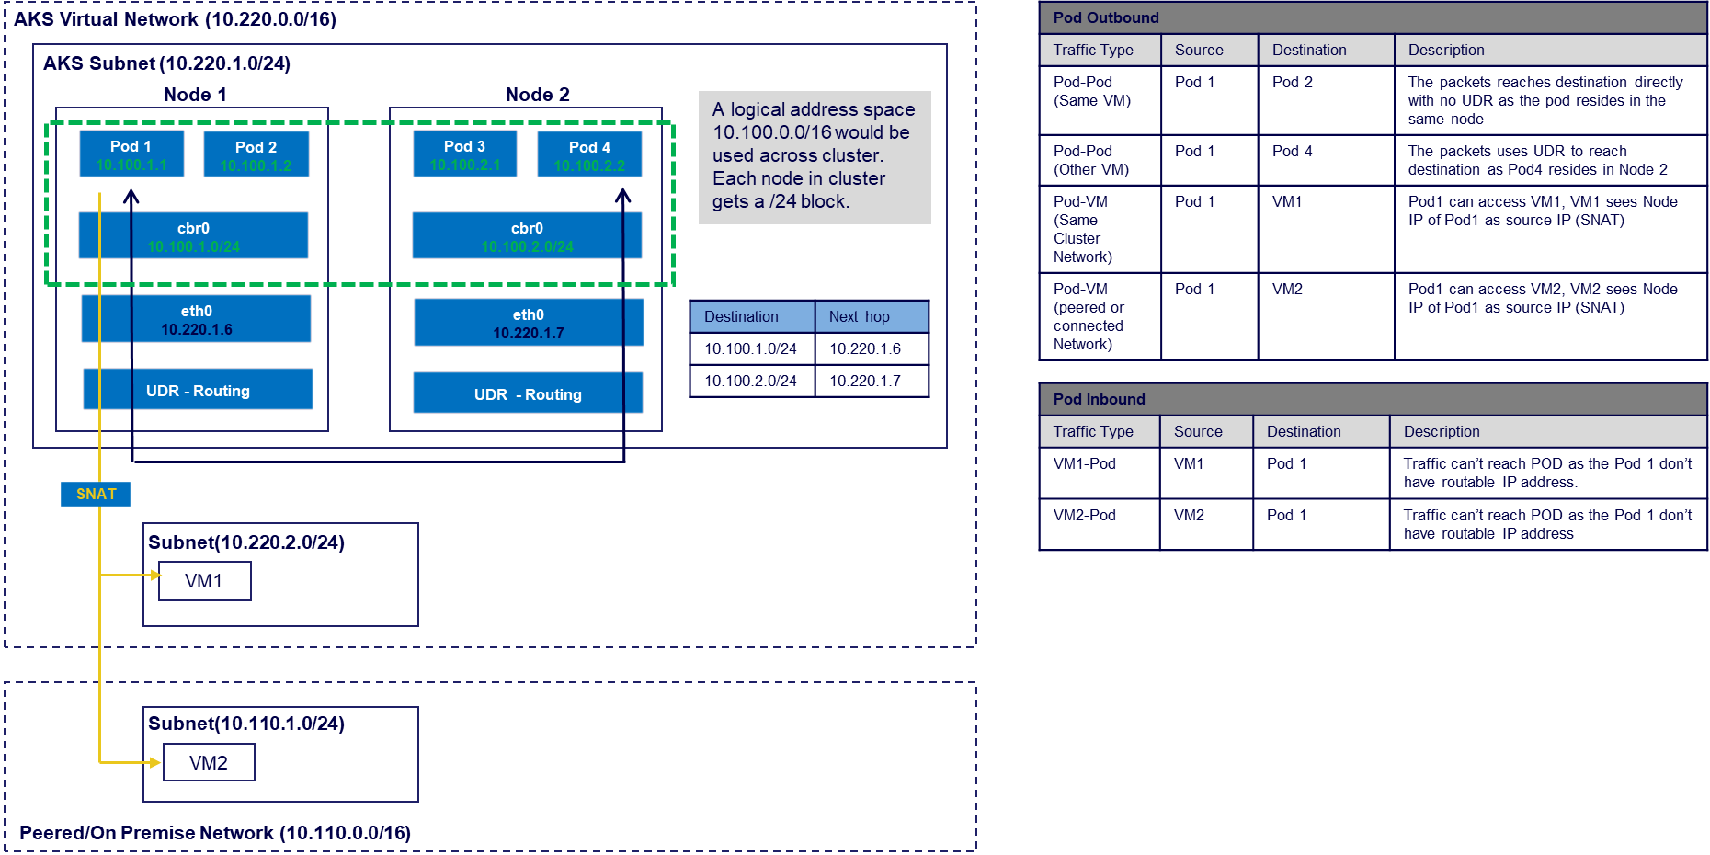
Pod Connectivity - Kubnet

Slide 13
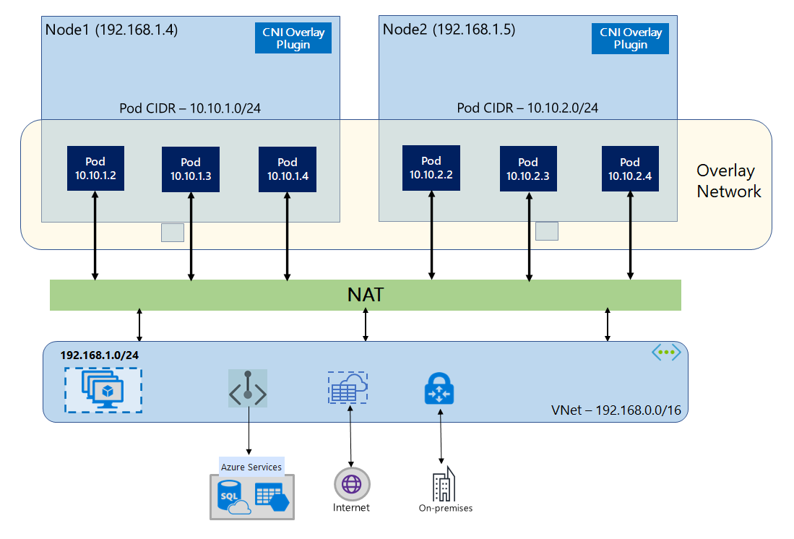
Azure CNI Overlay networking in (AKS) - Preview
Summary:
Cluster nodes go into a subnet in your VNet, so verify you have a subnet large enough to account for future scale.
Pod IPs are received from a private CIDR at the time of creation, by default assigns a /24 address space for the POD
A separate overlay network and routing domain is formed between the pods and nodes.
Communication with endpoints outside the cluster, such as on-premises and peered VNets, happens using the node IP through NAT.
Azure CNI translates the Overlay IP of the pod to the node IP using NAT, which enables the Azure Networking stack to route the traffic to the destination.
Supports Azure Network Policies and Calico.
Supports Linux and Windows Server 2022.
Better alternate for Kubenet, as the complexity of introducing route tables
and UDRs on cluster subnet for pod networking is eliminated.

Slide 14
AKS Network Guidelines
Capability | Azure CNI | Kubenet
Multiple clusters in same subnet. | Supported | Not Supported
Performance | Performance is better since the UDR is not used for pod communication | Uses UDR for pod communication, adds extra hop that decreases performance
UDR Management | CNI will not use any UDR so we have full control. | Kubnet create its own rules which cannot be modified we can change only our custom rules.
IP Address for Pod | Requires proper IP address space planning | Separate CIDR will be used for Pods
Pod-VM connectivity (VM Can be in same or peered of connected Network) | Works both ways | Works when initiated by pod

Slide 15
AKS Network Guidelines
Capability | Azure CNI | Kubnet
Network Policy | Supports Azure Network Policy and Calico | Only Calico Supported
Maximum Nodes per Cluster | 1000 | 400
Default Maximum Pods per node | 30 (Maximum Pods grow up to 250) | 110 (Maximum Pods grow up to 250)
Suitable use Case | •Suitable for complex environment | •Small development or test workloads.
 | •Better network performance is required | •Simple websites with low traffic.
 | •When IP Adress Schema is planned and enough IPs available in pool. | •If enough number of IP addresses is not present.

Slide 16
Network Policies
Types:
Azure Network Policies : Azure's own implementation of policies
Calico Network Policies : An open-source network and network security solution founded by Tigera
Capability | Azure Network Policy | Calico
Supported platforms | Linux, Windows Server 2022 | Linux, Windows Server 2019 and 2022
Supported networking options | Azure CNI | Azure CNI (Windows Server 2019 and Linux) and kubenet (Linux)
Additional features | None | Extended policy model consisting of Global Network Policy, Global Network Set, and Host Endpoint. Calicoctl CLI provides the options to manage the policies.
Support | Supported by Azure support and Engineering team | Calico community support. Additional paid support available from vendor
Logging | Rules added / deleted in IPTables are logged on every host under /var/log/azure-npm.log | All the logs are logged in to /var/log/calico. All logging is done using svlogd.
Compliance with Kubernetes specification | All policy types supported | All policy types supported

Slide 17
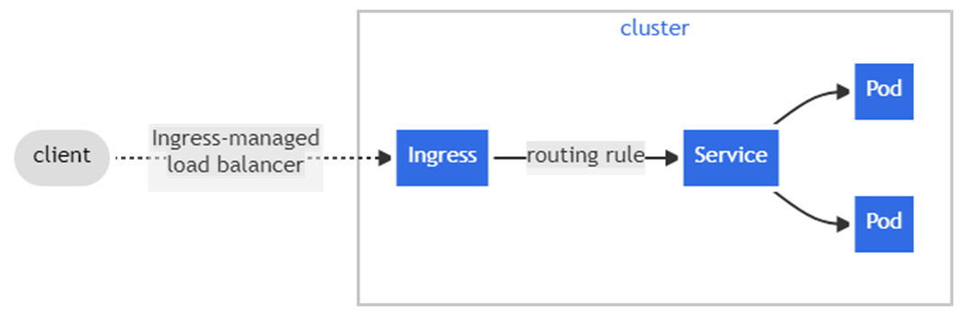
Ingress Controller
Ingress is a collection of rules that allow inbound connections to reach cluster services.
An ingress controller provides reverse proxy, configurable traffic routing, and TLS termination for Kubernetes services.
It Provides Layer 7 Load balancing features for routing external traffic to applications hosted on Kubernetes PODS.
Ingress is not deployed in Kubernetes as default. We need to deploy it separately based on the requirements
When we use an ingress controller and ingress rules, a single IP address can be used to route traffic to multiple services in a Kubernetes cluster.

Slide 18
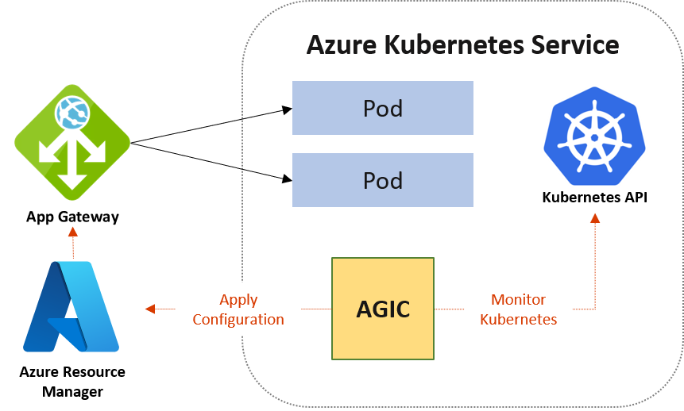
Application Gateway Ingress Controller
AGIC helps eliminate the need to have another load balancer/public IP in front of the AKS cluster and avoids multiple hops in your datapath before requests reach the AKS cluster.
Application Gateway talks to pods using their private IP directly and doesn't require NodePort or KubeProxy services. This also brings better performance to your deployments.
Ingress Controller is supported exclusively by Standard_v2 and WAF_v2 SKUs, which also brings autoscaling benefits.
Application Gateway in addition to AGIC also helps protect your AKS cluster by providing TLS policy and Web Application Firewall (WAF) functionality.

Slide 19
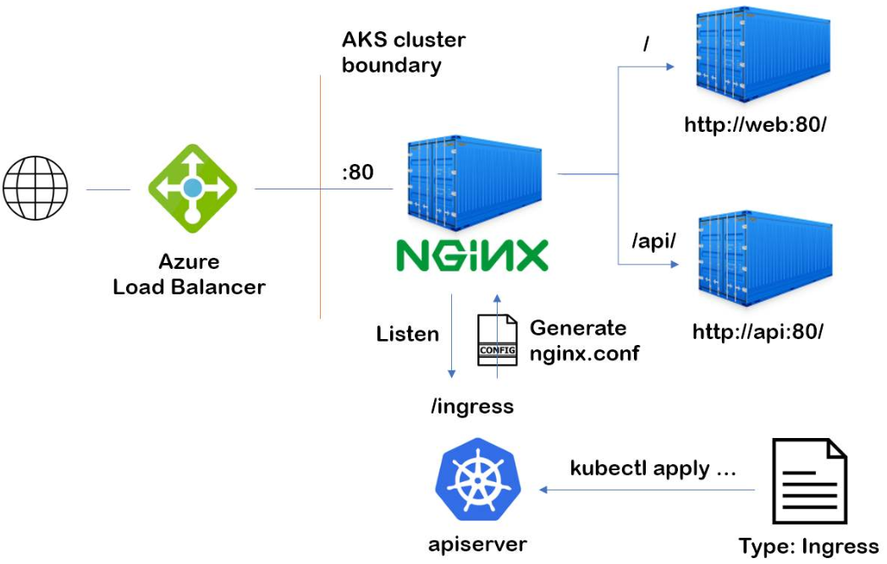
NGINX Ingress Controller
A universal Kubernetes-native tool for implementing load balancers, and Ingress controllers at the edge of a Kubernetes cluster.
NGINX ingress controller for Kubernetes manages networking, controls traffic, and enhances security on Layers 4 through 7.

Slide 20
 | AGIC | Nginx
Definition | Use Azure Application Gateway as the Load Balancing tool This uses Azure Application gateway ingress controller | Use Azure Load balancer as the Endpoint for exposing applications deployed on AKS. This uses Nginx as the Ingress Controller
Support | Microsoft Support Available | Microsoft Support Not Available. commercial version can be purchased from F5.
Layer 7 & Layer 4 Support | Only Layer 7. Need to include one more Azure LB for Layer 4 | With out Nginx its layer 4 and with Nginx its Layer 7
Popularity & long in market | Microsoft Native Solution but new to this Area | Nginx is the most widely used Kubernetes Ingress Controller
Cost | AAG is more expensive compared to Nginx | Open source is less need to pay for F5 like support if required
Performance | Less hops. All Layer 7 functionalities moved out of AKS Theoretically it should better but most cases performance same. | All Layer 7 functionalities like TLS, URL rewriting, traffic management needs to be done at K8s only
Other Features | Autoscaling, Zone redundancy, HA is built in and WAF inspection are supported | Consider adding redundancy by deploying 2 replicas of the ingress controller for HA.
Provisioning and management overhead | HA is inbuilt. Provisioning is simple but configuration might get complex. | Complex setup and configuration compared to AGIC. HA setup add additional work and complexity.

Slide 21
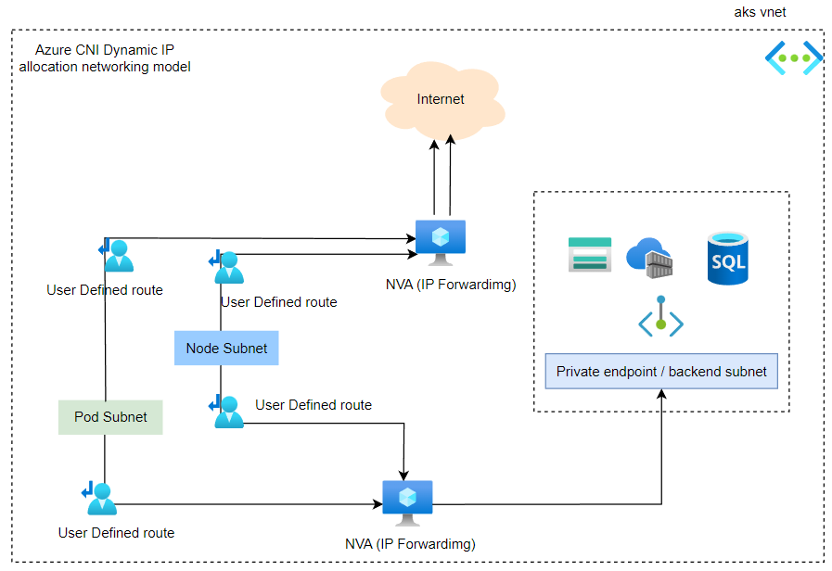
Egress Traffic
Uniper Environment will be configured with multiple User
defined Routes to force the traffic through Enterprise Grade
Firewalls (Checkpoint and Fortigate)
For On-premise Connectivity:
OnPrem->Checkpoint in Azure->Azure VM
Azure VM->Checkpoint in Azure-> Onpremise
For Azure AAD Domain Service Connectivity
Azure VM->Checkpoint in Azure-> AAD Domain Service
For Third Party VPN Connectivity
Azure VM/Onpremise->Checkpoint in Azure-> Fortigate in Azure -> Third Party

Slide 23
Thank you!

